Slide 1
Edge Computing Benefits in Low-Latency IoT Applications
Michael Amista’
Exam of 22nd February 2025
Prof. Claudio Enrico Palazzi
Wireless Networks for Mobile Applications
2024-2025

Slide 2
Table of contents
Internet of Things
Limitations of traditional Cloud Computing
Emergence of Edge Computing
Computing paradigms
A study on Mobile Edge Computing (MEC)
Case studies
Mobile Gaming
Industrial Manufacturing
Open research challenges

Slide 3
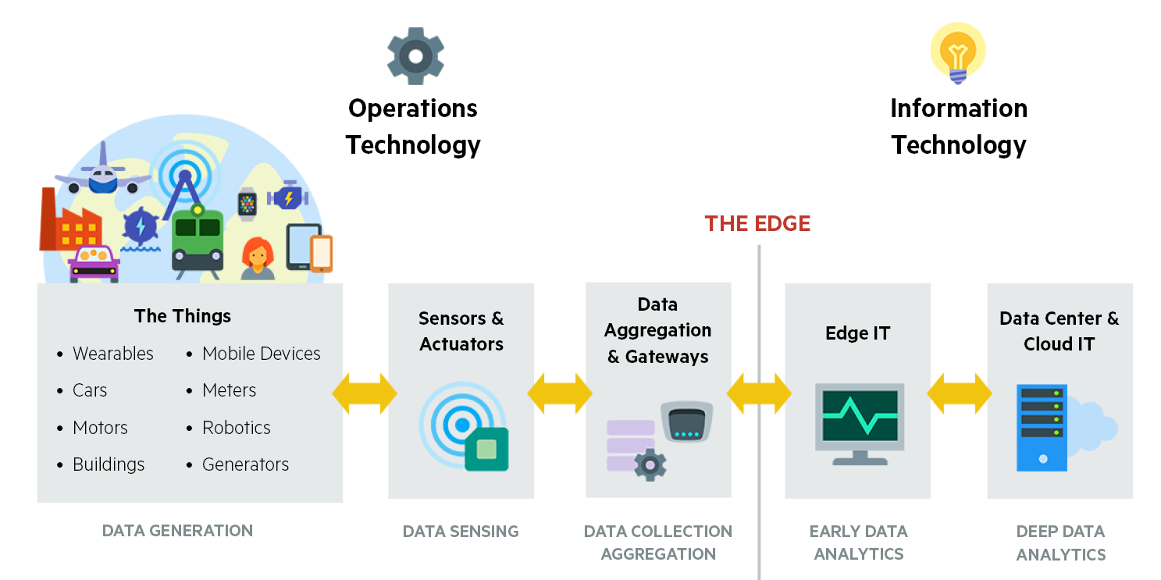
Internet of Things

Slide 4
Limitations of traditional Cloud Computing
Network Bandwidth: Sending large volume of data to centralized cloud servers may lead to network congestion.
Communication Latency: The physical distance from the servers introduces substantial processing delays.
Resource Inefficiency: Sending all the collected data to remote servers may be critical for energy-constrained devices.
Privacy and Security Concerns: Continuous data transmissions to external servers may be a potential point of attack.

Slide 5
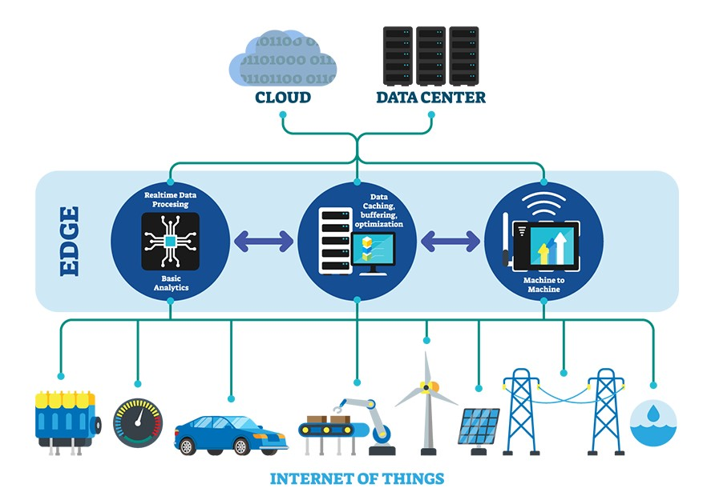
Emergence of Edge Computing
Key features:
Proximity to data
Reduced latency
Real-time processing
capabilities
Enhanced energy
efficiency and data
security

Slide 6
Computing paradigms
Centralized Cloud Computing: Processes all data in remote servers.
Fog Computing: Localized processing on network devices like routers.
Cloudlet Computing: Small servers near IoT devices for low-latency tasks.
Mobile Edge Computing (MEC): Computing at mobile network edges for real-time responses.
Mobile Ad Hoc Cloud (MAC): Dynamic use of nearby mobile devices for processing.
Hybrid Computing: Combines cloud and edge for balanced performance.

Slide 7
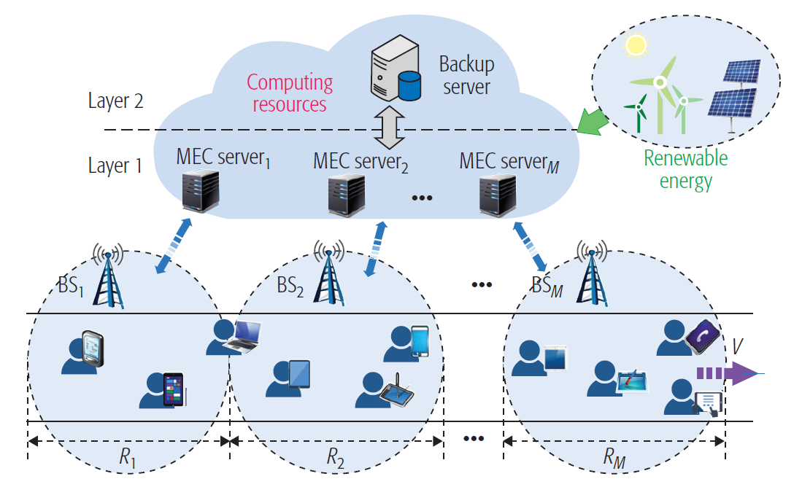
A study on Mobile Edge Computing (MEC)
Figure 2. Mobility-aware hierarchical MEC framework.

Slide 8
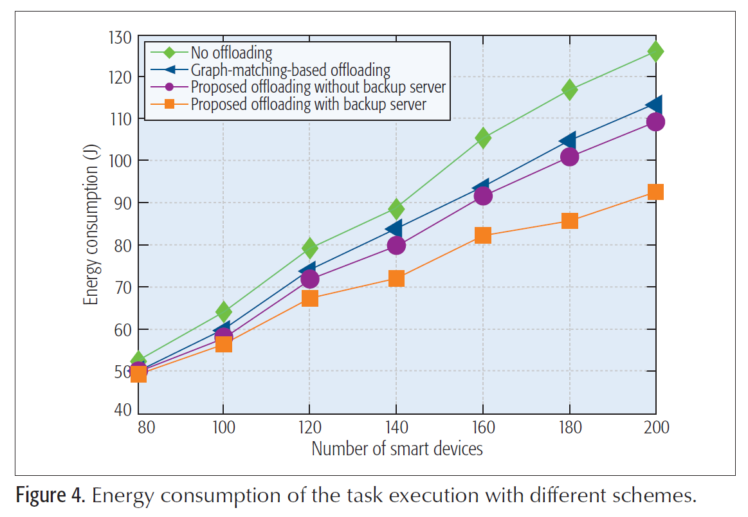
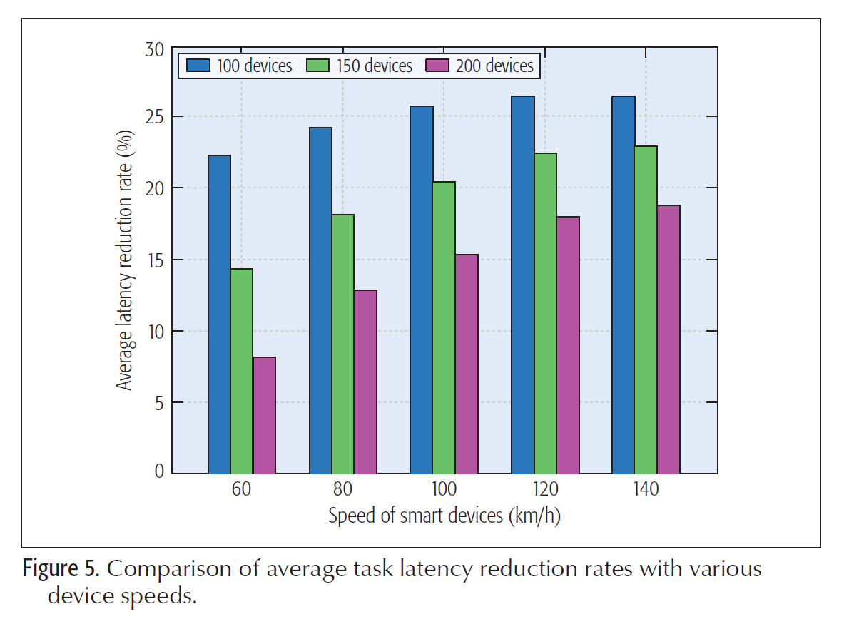
A study on Mobile Edge Computing (MEC)

Slide 9
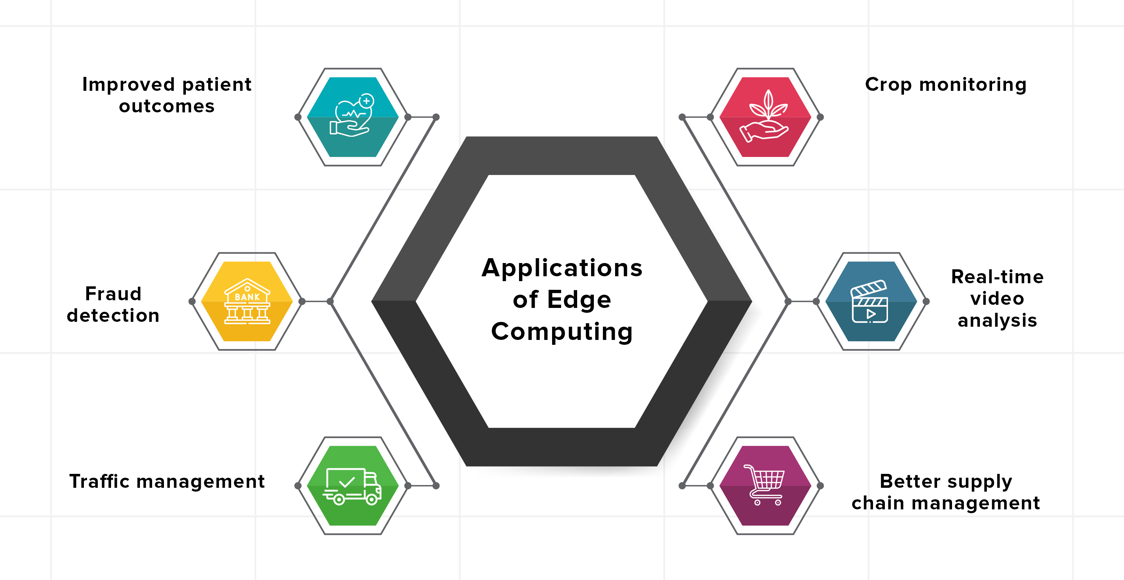
Edge computing applications

Slide 10
A study on mobile gaming
Objective: Evaluate the impact of edge computing on latency in resource-demanding mobile gaming applications.
Experimental Setup:
Platform: GamingAnywhere, an open-source cloud gaming framework.
Client Device: Google Nexus 5 mobile phone.
Server: Workstation with Intel Xeon E3-1230 CPU, 16GB RAM, and NVIDIA GPUs.
Network Technologies: Wi-Fi and LTE.
Comparison Scenarios:
Local Edge Deployment: Server located at the network edge.
Specialized Cloud Infrastructure: Centralized cloud computing.
Key Metrics: Response delay, comprising processing delay (PD), network delay (ND), and playout delay (PD).

Slide 11
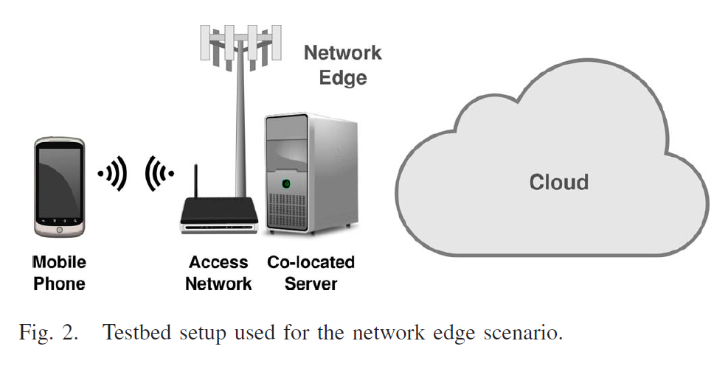
A study on mobile gaming

Slide 12
A study on mobile gaming
Findings:
Latency: Edge setup achieved network delay (ND) of <20ms, outperforming cloud setups which showed >50ms delay.
Virtualization: Containers delivered near-bare-metal performance, while hypervisor virtualization incurred ~30% higher processing delay.
Resolution: Full HD processing times at the edge were significantly better compared to centralized cloud setups.
Implications:
Edge computing enables high-quality gaming with latency <70ms, essential for immersive experiences.
Cloud setups, despite better computational resources, fall short in latency-critical scenarios like gaming.
Conclusion: Proximity of computational resources in edge computing is critical for enhancing user experience in mobile gaming applications.

Slide 13
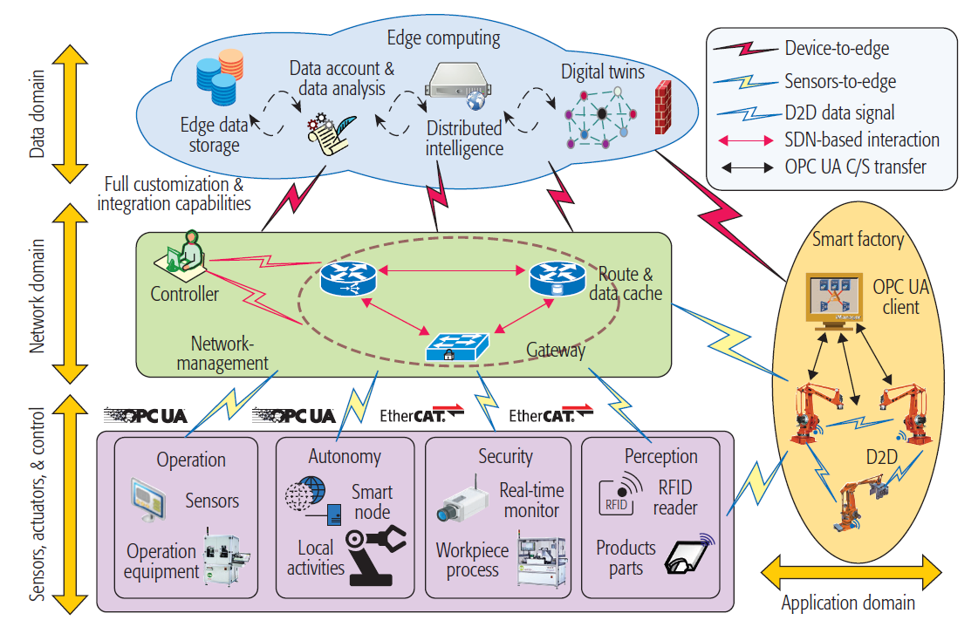
A study on industrial manufacturing
Figure 1. Architecture of an edge computing platform in IoT-based manufacturing.

Slide 14
A study on industrial manufacturing
Objective: Explores the integration of edge computing in IoT-based manufacturing to address latency, real-time analytics, and resource efficiency.
Key Benefits:
Active Maintenance:
Enhanced responsiveness through localized processing.
Case study on candy packaging line showed a 60% reduction in network traffic (from 16-17 Mb/s to 5-6 Mb/s) with improved order handling efficiency.
Cloud-Edge Cooperation:
Cloud layers handle long-term data analysis, maintenance planning, and knowledge mining.
Edge layers focus on real-time processing, security, and immediate business logic execution, ensuring a balanced workload.

Slide 15
A study on industrial manufacturing
Implementation Challenges:
Protocol compatibility across legacy and modern systems.
Real-time processing for time-sensitive manufacturing tasks.
Integration with existing infrastructure while ensuring scalability.
Future Directions:
Evolution of digital twins for manufacturing optimization.
Enhanced autonomous systems for process management.
Continued development in network optimization for seamless edge-cloud integration.

Slide 16
Open research challenges
Heterogeneity: Need for standardized programming models for diverse devices.
Resource Management: Efficient allocation in dynamic, constrained environments.
Security & Privacy: Safeguarding sensitive data against evolving threats.
Data Handling: Efficient preprocessing of large IoT data volumes.
System Reliability: Ensuring consistent and scalable service delivery.

Slide 17
References
N. Hassan, S. Gillani, E. Ahmed, I. Yaqoob and M. Imran, "The Role of Edge Computing in Internet of Things," in IEEE Communications Magazine, vol. 56, no. 11, pp. 110-115, November 2018, doi: 10.1109/MCOM.2018.1700906.
G. Premsankar, M. Di Francesco and T. Taleb, "Edge Computing for the Internet of Things: A Case Study," in IEEE Internet of Things Journal, vol. 5, no. 2, pp. 1275-1284, April 2018, doi: 10.1109/JIOT.2018.2805263.
B. Chen, J. Wan, A. Celesti, D. Li, H. Abbas and Q. Zhang, "Edge Computing in IoT-Based Manufacturing," in IEEE Communications Magazine, vol. 56, no. 9, pp. 103-109, Sept. 2018, doi: 10.1109/MCOM.2018.1701231.
K. Zhang, S. Leng, Y. He, S. Maharjan and Y. Zhang, "Mobile Edge Computing and Networking for Green and Low-Latency Internet of Things," in IEEE Communications Magazine, vol. 56, no. 5, pp. 39-45, May 2018, doi: 10.1109/MCOM.2018.170

